Slide 1


ML-KEM-Based Quantum-Resilient Checkpoint File Transfer Protocol
For Simulated 6G Networks
Project Team
Fathima Fahmiya S (2024503003)
Nivriti Muthuvairavan (2024503005)
Mounika KM (2024503577)
Tharun P (2024503579)

Slide 2


Problem Statement
1. The 6G Reliability Challenge
2. The Quantum Cryptanalytic Threat
■
Future 6G networks promise ultra-high speeds but rely on Terahertz (THz) frequencies.
■
Traditional public-key cryptography (RSA, ECC) used for session security is vulnerable to future large-scale quantum computers running Shor's algorithm.
■
These signals are highly vulnerable to physical blockage, user mobility, and frequent cell handovers.
■
"Store Now, Decrypt Later" (SNDL) attacks necessitate immediate adoption of Post-Quantum Cryptography (PQC).
■
Existing secure file transfers (TCP/TLS) typically restart from scratch or retransmit massive data chunks after these frequent disconnections, wasting bandwidth.
■
However, PQC introduces larger key sizes and processing overhead, making connection restarts even more costly.
ML-KEM 6G Protocol Research
Slide 2

Slide 3
Research Gaps & Objectives
■
Identified Gap 1: Lack of lightweight, checkpoint-based recovery mechanisms that can resume a file transfer exactly where it left off without repeating full key-exchanges.
■
Identified Gap 2: Post-quantum mechanisms (ML-KEM/CRYSTALS-Kyber) are not widely evaluated in combination with recovery designs under realistic 6G network conditions.
■
Identified Gap 3: Unmeasured performance trade-offs between PQC overhead (larger ciphertexts) versus the reliability gains of checkpointing in edge scenarios.
■
Primary Objective: Design, implement, and evaluate a quantum-resilient file transfer protocol combining ML-KEM, AES-256 GCM, and a checkpoint mechanism to automatically continue interrupted transfers over simulated 6G channels.
ML-KEM 6G Protocol Research
Slide 3

Slide 4
Proposed Methodology (12-Week Plan)
Month 1: Foundation
Month 2: Implementation
Month 3: Analysis
Literature review of NIST FIPS 203 (ML-KEM) and AES-256 GCM. Set up development environment (C++/Python, liboqs). Build 6G simulator (Mininet/NS-3) and conduct baseline experiments without checkpointing.
Execute comparative testing: baseline vs. proposed protocol. Analyze recovery time, retransmission overhead, throughput, and PQC compute cost. Finalize IEEE format report and architectural diagrams.
Implement core protocol: ML-KEM session establishment, AES-256 chunk encryption. Develop checkpoint manager to log verified chunk hashes. Implement automatic resume logic handling simulated THz disruptions.
ML-KEM 6G Protocol Research
Slide 4

Slide 5
















System Architecture (Block Diagram)
Quantum-Resilient Checkpoint File Transfer Flow
Sender Node
Receiver Node
Simulated 6G Channel
ML-KEM 6G Protocol Research
Slide 5

Slide 6
Architecture & Environment Additions
Supplement to the ML-KEM Quantum-Resilient Checkpoint File Transfer Protocol
Network Placement (Interface)
Sharing Entity
Development OS
ML-KEM 6G Protocol Research
Slide 1

Slide 7
Network Placement: Which Interface?
Correction: E1 / E2 are O-RAN control-plane interfaces (session setup, RIC control) — they do not carry user file data. A file transfer rides the user plane, a different path entirely.
Uu
(THz air link)
N3 / NG-U
N6
UE
(Sender)
gNB
(6G base st.)
UPF
(User Plane Fn)
UE
(Receiver)
6G-evolved user plane (Rel-20 architecture, not yet frozen)
Anchor interface
Where disruptions happen
N3 / NG-U — the RAN-to-core user plane. Closest honest analog to “pick one named interface,” and where your encrypted chunks actually flow.
The Uu air link (6G-evolved THz) is where the blockages, handovers and losses you inject with netem occur — the trigger for checkpoint resume.
ML-KEM 6G Protocol Research
Slide 2

Slide 8
Sharing Entity: Who Moves the File
Primary entity
Recommended upgrade
UPF — User Plane Function
Checkpoint state at the 6G edge (MEC)
The core entity whose entire job is forwarding user data packets. Every byte of your encrypted chunks passes through it.
Your Sender and Receiver Nodes map to two
UEs (or a UE and an app server in the Data Network); the UPF routes between them.
Hold the verified chunk-index / hash state at an edge (MEC) host co-located with the UPF, not end-to-end only. The checkpoint then survives at the edge even when the air link drops.
Why this framing is defensible
UPF is the only 5G/6G entity that forwards user-plane data — reviewers expect the file to pass through it.
6G is designed as “integrated communication + computing” — pushing state to the edge is on-trend, not invented.
Edge-held checkpoint = stronger research contribution — resume works even when the end device loses the link.
ML-KEM 6G Protocol Research
Slide 3

Slide 9
Development Environment: Ubuntu Linux
Decision: Ubuntu 22.04 LTS (64-bit) inside a VMware VM — the entire project (simulation, crypto, capture, benchmarking) runs on one Linux VM.
Why Linux is mandatory
VM setup & caveats
Mininet — runs only on Linux (network namespaces).
tc / netem — Linux kernel module; injects your 6G latency, jitter & THz disruptions. No Win/Mac equivalent.
NS-3 — builds cleanly on Linux, painful elsewhere.
liboqs (ML-KEM / FIPS 203) — compiles out of the box on Ubuntu.
Reuse your existing VMware setup from the Wireshark labs.
Allocate 4+ GB RAM and 4 cores — NS-3 compiles are heavy.
Avoid WSL2 — flaky netem timing muddies your latency results.
Comparative results still hold — baseline vs. checkpoint is relative, so VM overhead cancels out.
Dual-boot only if you want cleaner absolute timing for the benchmark slides.
ML-KEM 6G Protocol Research
Slide 4

Slide 10
File Transfer A → B — Protocol Flowchart with Delay Components
START
(Computer A)
Open TCP connection (3-way handshake)
≈ 1.5 RTT
ML-KEM-768 handshake pk 1184 B → ct 1088 B
≈ 1–2 ms (RTT dominates)
HKDF → derive AES-256-GCM session key
µs-scale
Split file into sequenced chunks
one-time
Checkpoint {index, hash, key} — both sides
1–10 ms fsync — batch every N chunks
B: decrypt, verify tag + hash, send ACK
+1 RTT (ack)
Transmit [seq | nonce | ct | tag]
T_tx = size ÷ bandwidth
Encrypt chunk (AES-GCM + auth tag)
tens of µs / chunk
resume from last verified index + 1
No — next chunk
All chunks
ACKed?
Link
disrupted?
Detect via RST / timeout → pause
2–5 s worst case
Reconnect (backoff) + RESUME {sid, index} — no re-key
1s→2s→4s… + 1 RTT
No
Yes
Yes
Final SHA-256 whole-file verify
match → done
END
ML-KEM 6G Protocol Research
Slide 1

Slide 11
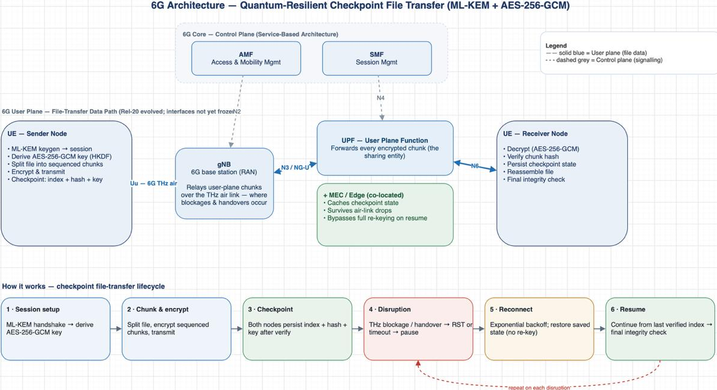

Slide 12
Latency & Delay Breakdown
Network delays (per packet)
Protocol delays (yours to measure)
Delay | Formula | 6G sim value (netem)
Transmission | size ÷ bandwidth | 64 KB @ 1 Gbps ≈ 0.52 ms
Propagation | distance ÷ signal speed | delay 0.1–1 ms (THz short range)
Queuing + processing | buffer wait (the jitter) | delay 0.5ms 0.2ms (± jitter)
Delay | Magnitude | Note
ML-KEM handshake | ≈ 1–2 ms | ops are µs; RTT dominates
Crypto per chunk | tens of µs | AES-NI runs at GB/s
Checkpoint write | 1–10 ms ⚠ | fsync — batch or async
Disruption detection | 2–5 s | timeout worst case; RST instant
Reconnect + resume | backoff + 1 RTT | no re-key, no re-send
Recovery time after a disruption — the headline metric
Baseline (no checkpoint): T = detect + reconnect + FULL ML-KEM handshake + retransmit ALL verified chunks
Proposed protocol: T = detect + reconnect + 1 RTT resume + remaining chunks only
Example:
100 MB file interrupted at 80% — baseline re-sends 80 MB (≈ 0.7 s pure transmission @ 1 Gbps) + a fresh 2.3 KB ML-KEM exchange; the proposed protocol re-sends ≈ 0. Plot this gap vs. interruption count.
Measure with time.perf_counter() around each phase; separate network vs. processing delay via Wireshark timestamps; report mean ± std over 10+ runs.
ML-KEM 6G Protocol Research
Slide 2

Slide 13



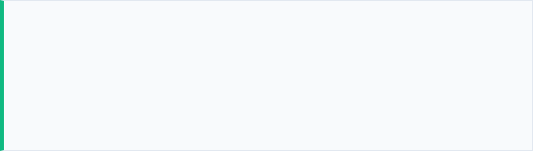
Checkpoint-Based Recovery Logic
The core innovation reduces overhead during frequent 6G THz signal blockages by eliminating the need to re-execute the ML-KEM handshake or retransmit verified data.
3. Disruption Detection
Detect TCP RST/FIN flags or timeouts simulating 6G cell handovers or physical blockages. Pause transfer.
1. Initialization & Chunking
Establish ML-KEM session, derive AES-256 key. Split file into sequenced, encrypted chunks.
4. Reconnection Wait
Client waits for network restoration, utilizing exponential backoff algorithms.
2. Transmission & Checkpointing
Transmit chunks. Both nodes persist state (chunk index + hash + key material) after successful verification.
5. Secure Recovery
Reconnect, bypass full key exchange via saved state, and resume transmission from the last verified index. Verify final integrity upon completion.
ML-KEM 6G Protocol Research
Slide 6

Slide 14





State-of-the-Art Tools & Technologies
Post-Quantum Crypto
6G Channel Simulation
Analysis & Benchmarking
liboqs (Open Quantum Safe): C++ / Python bindings used to implement ML-KEM (FIPS 203) for key encapsulation.
NS-3 / Mininet: Creates accurate network topologies.
Wireshark: Deep packet inspection to verify ciphertexts and AL framing.
Linux tc (Traffic Control) / netem: Injects realistic 6G attributes including sub-millisecond latency, jitter, and modeled THz disruption events.
PyCryptodome / OpenSSL: Utilized for symmetric AES-256-GCM authenticated bulk encryption and HKDF key derivation.
iPerf / Matplotlib: Capturing throughput degradation data, measuring recovery latency, and plotting comparative performance graphs.
ML-KEM 6G Protocol Research
Slide 7

Slide 15
Complexity Analysis & Performance Feasibility
Transitioning to PQC increases bandwidth overhead, necessitating the checkpoint resume architecture to maintain 6G throughput.
Cryptographic Scheme | Security Target | Public Key Size | Ciphertext Size | Encapsulation Speed
ECDH (NIST P-256) | Pre-Quantum (Vulnerable) | 64 Bytes | 64 Bytes | ~1.2 x 10^6 Cycles
ML-KEM-512 | Post-Quantum (NIST L1) | 800 Bytes | 768 Bytes | ~0.4 x 10^5 Cycles
ML-KEM-768 | Post-Quantum (NIST L3) | 1184 Bytes | 1088 Bytes | ~0.6 x 10^5 Cycles
■
Feasibility Assessment: While ML-KEM requires significantly fewer CPU cycles (faster encapsulation), the public key and ciphertext sizes are >12x larger than traditional ECDH.
■
Conclusion: In a lossy 6G environment, restarting a connection without a checkpoint forces repeated transmission of these large ML-KEM payloads, degrading throughput. The proposed protocol mitigates this entirely.
ML-KEM 6G Protocol Research
Slide 8

Slide 16
Literature Review & Key References
Reference Source | Focus Area | Relevance to Proposed Solution
NIST FIPS 203 (Aug. 2024) | Standardization | Provides the definitive technical specification for ML-KEM, guiding the implementation of the key encapsulation module.
Sosnowski et al. (CoNEXT '23) | Performance Analysis | Empirical analysis of Post-Quantum TLS 1.3 performance, serving as a baseline metric for our protocol's latency measurements.
Serghiou et al. (IEEE '22) | 6G Propagation Modeling | Details Terahertz channel phenomena and blockage rates, used to parameterize the NS-3/Linux tc disruption simulation correctly.
IETF RFC 765 (FTP) | Protocol Architecture | Historical context on file transfer state management, highlighting the evolution required for modern, chunk-based resume mechanics.
ML-KEM 6G Protocol Research
Slide 9

